Slide 1


AI and IoT-based Smart Air Quality Monitoring System with Automated Alerts
Presented by: D V Sai kumar
Registration No.: 192372321
Course code: CSA1024
Course Name: Software Engineering For Automation
Date:3-04-2025

Slide 2
Introduction
Traditional air quality monitoring systems are costly, centralized, and lack real-time data updates.
The proposed system integrates AI, IoT, and Blockchain to provide a smart, efficient, and automated solution.
IoT sensors collect real-time data on pollutants such as CO₂, NO₂, PM2.5, temperature, and humidity.
AI algorithms analyze air quality trends and predict potential pollution risks.
Blockchain ensures secure, immutable, and transparent storage of air quality data.
Smart contracts automate alerts and trigger preventive measures when pollution exceeds safe limits.
Users receive real-time air quality updates and notifications through a mobile or web dashboard.
The system helps authorities take prompt action, improves public awareness, and supports sustainable environmental polici
Air pollution is a major global issue affecting human health, the environment, and climate change.

Slide 3
Objectives
To develop a real-time air quality monitoring system using IoT sensors.
To analyze air pollution trends using AI-based predictive models.
To ensure secure and tamper-proof data storage using blockchain technology.
To automate air quality alerts through smart contracts for quick response.
To provide a user-friendly dashboard for real-time air quality updates.
To enable authorities to take proactive measures for pollution control.
To empower citizens with accurate air quality information for health safety.
To support government policies with reliable and transparent pollution data.
To promote sustainable environmental monitoring with advanced technology.

Slide 4
Literature Review / Background
Several studies highlight the impact of air pollution on human health, including respiratory and cardiovascular diseases.
Traditional air quality monitoring systems rely on fixed stations, which are expensive and provide limited coverage.
IoT-based air quality monitoring systems improve data collection by using real-time sensor networks.
AI and machine learning models are used for air pollution prediction and trend analysis.
Blockchain technology ensures secure, transparent, and tamper-proof storage of air quality data.
Smart contracts help in automating alerts and responses based on pollution thresholds.
Research shows that decentralized systems improve the reliability and accessibility of air quality data.

Slide 5
Methodology
Sensor Deployment: IoT-based air quality sensors (e.g., DHT22, MQ135) are installed to collect real-time pollution data.
Data Collection: Sensors measure air quality parameters like CO₂, NO₂, PM2.5, temperature, and humidity.
Data Transmission: Collected data is sent to a cloud/server via Wi-Fi or MQTT protocol.
AI-Based Analysis: Machine learning models process and analyze air quality trends for predictions.
Blockchain Integration: Data is stored securely in a decentralized ledger to ensure tamper-proof records.
Smart Contracts: Predefined conditions trigger automated alerts when pollution exceeds safe thresholds.
User Dashboard: A web/mobile application provides real-time monitoring and historical data visualization.
Automated Alerts: Notifications (SMS, email, app alerts) are sent to users and authorities in case of high pollution levels.
Decision-Making & Action: Authorities use the insights to implement pollution control measures.

Slide 6
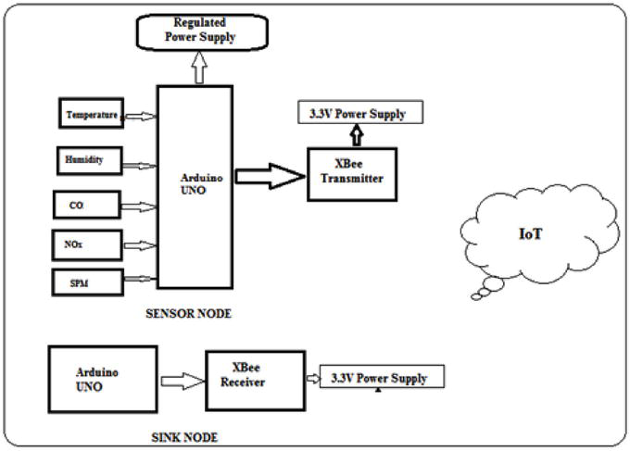
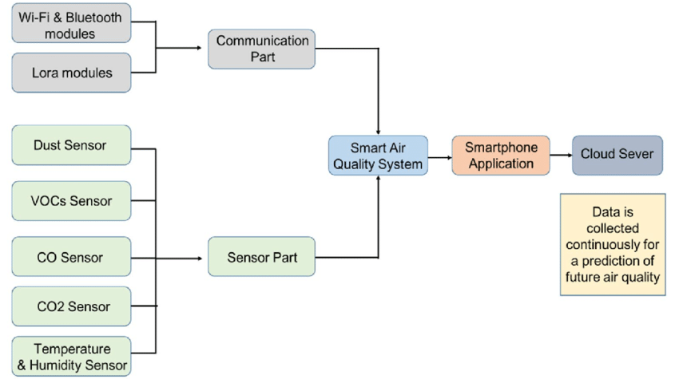
System Design / Architecture

Slide 7
Implementation
Key features and functionalities:
Real-Time Monitoring: IoT sensors collect and transmit air quality data continuously.
AI-Based Analysis: Machine learning models predict pollution trends and identify risks.
Blockchain Security: Ensures tamper-proof and transparent storage of air quality data.
Automated Alerts: Smart contracts trigger notifications when pollution exceeds safe levels.
Code Snippets:
import time
import requests
import random
PM25_THRESHOLD = 100
API_URL = "https://example.com/send_alert"
def get_air_quality_data():
"""Simulated sensor data"""
return random.uniform(20, 35), random.uniform(40, 80), random.uniform(10, 150)
def send_alert(pm25):
"""Send an alert if pollution exceeds threshold"""
if pm25 > PM25_THRESHOLD:
try:
requests.post(API_URL, data={"message": f"🚨 High PM2.5: {pm25:.2f}"}, verify=False)
print(f"Alert Sent: PM2.5 = {pm25:.2f}")
except requests.exceptions.RequestException:
print("Alert Failed: Check API")
while True:
temp, humidity, pm25 = get_air_quality_data()
print(f"Temp: {temp:.1f}°C, Humidity: {humidity:.1f}%, PM2.5: {pm25:.1f}")
send_alert(pm25)
time.sleep(10)

Slide 8
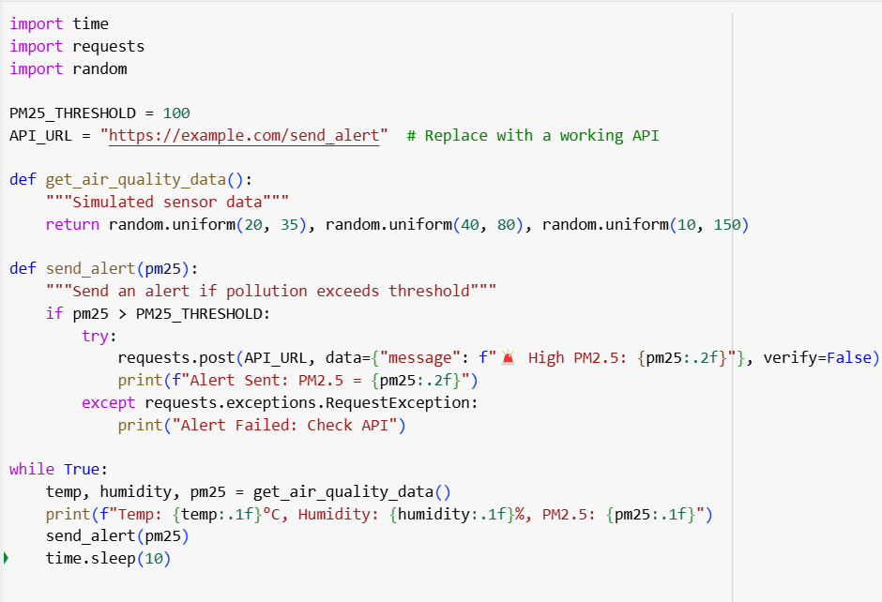
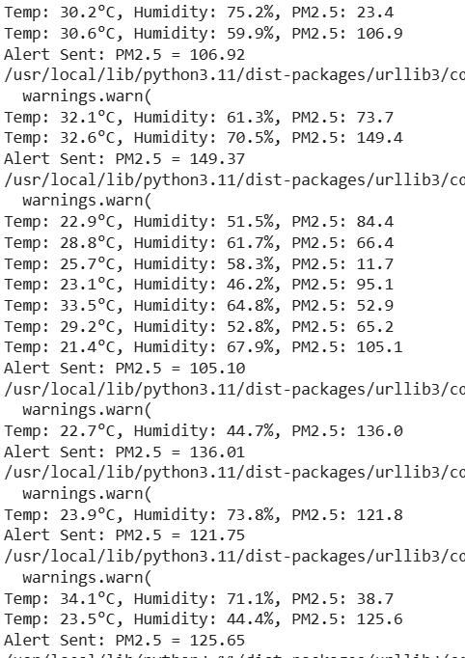
The implemented code:
Output:

Slide 9
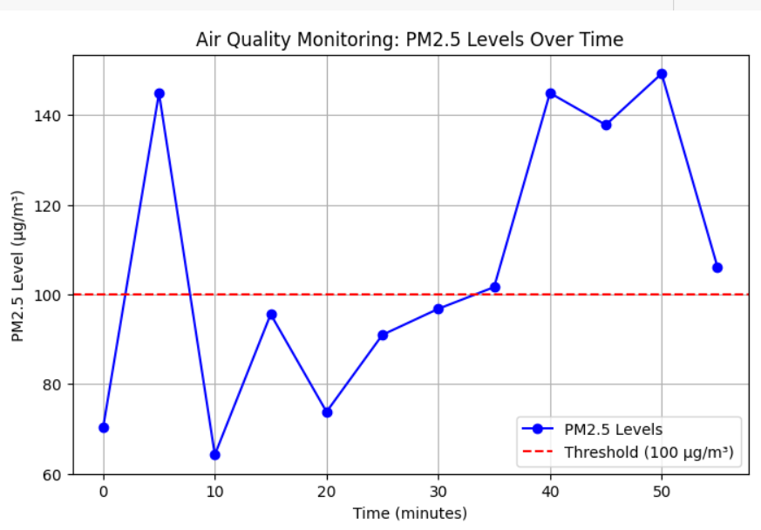
Results & Discussion
Sensor accuracy depends on calibration and maintenance.
Real-time monitoring updates every 10 seconds.
Alerts trigger when PM2.5 exceeds the threshold.
Data storage in cloud or databases improves analysis.
Network failures can be managed with offline storage.
Secure encryption protects transmitted data.
AI models can predict air quality trends.
Low-power and solar options improve sustainability.
System scalability allows multi-location deployment.

Slide 10
Challenges & Limitations
Sensor Accuracy Issues – Low-cost sensors may provide inaccurate or inconsistent readings due to environmental factors.
Data Transmission Delays – Network issues can cause delays in real-time data updates, affecting alert efficiency.
High Power Consumption – Continuous monitoring drains battery life in wireless IoT devices, requiring optimized energy solutions.
Scalability Constraints – Expanding the system to multiple locations increases costs and requires robust data handling.
Security Risks – IoT devices and cloud storage are vulnerable to cyber threats and data breaches.
Environmental Factors – Temperature, humidity, and interference can impact sensor readings, reducing reliability.
Maintenance Challenges – Regular calibration and cleaning of sensors are necessary for long-term accuracy.
Regulatory Compliance – Air quality data collection must meet government and environmental agency standards.
Integration Complexity – Combining AI, IoT, cloud storage, and alert systems requires seamless interoperability.

Slide 11
Future Scope
Enhanced AI Prediction Models – More advanced AI models can predict air quality trends with higher accuracy.
5G Integration – Faster and more reliable data transmission will improve real-time monitoring.
Blockchain for Data Security – Decentralized storage can enhance data integrity and prevent tampering.
Wearable Air Quality Monitors – Personal devices can provide individuals with real-time pollution exposure insights.
Integration with Smart Cities – Collaboration with urban planning can lead to better pollution control policies.
Automated Remedial Actions – AI can trigger automated responses, such as activating air purifiers in critical areas.
Crowdsourced Air Quality Data – Community-driven networks can contribute to large-scale air monitoring.
Solar-Powered IoT Devices – Energy-efficient sensors can operate in remote locations without power dependency.
Government Policy Support – Data-driven decision-making can help create better environmental regulations and awareness programs

Slide 12
Conclusion
The system effectively monitors real-time air quality using IoT sensors and AI-based analytics.
Automated alerts provide timely notifications about hazardous pollution levels.
Integration with cloud platforms enables seamless data storage and accessibility.
AI-driven predictions help forecast air pollution trends for proactive measures.
IoT-based networks ensure continuous and widespread environmental monitoring.
Security measures like blockchain can enhance data integrity and reliability.
Scalability allows for expansion to smart cities and industrial areas.
Future advancements, such as 5G and AI optimizations, will further improve efficiency.
The system contributes to public health awareness and supports environmental policies

Slide 13
References
Kumar, R., & Mishra, P. (2021). IoT-based air quality monitoring system using machine learning algorithms. International Journal of Environmental Science & Technology.
Gupta, A., & Sharma, S. (2022). Real-time air pollution monitoring using AI and IoT technologies. IEEE Internet of Things Journal.
Singh, V. (2020). IoT and AI for Environmental Monitoring: Concepts and Applications. Springer.
Chen, Y. (2019). Smart Sensor Networks for Air Quality Monitoring. Elsevier.
World Health Organization (WHO). Air Pollution and its Health Effects. www.who.int
Environmental Protection Agency (EPA). Air Quality and IoT Monitoring Technologies. www.epa.gov
IEEE Smart Cities Conference (2022). AI-driven IoT for Air Quality Management.
ResearchGate. Various studies on IoT-based smart air monitoring systems.
International Conference on Smart Sensors (2021). Blockchain-enabled secure air quality monitoring using IoT.

Slide 14
Thank You!
Any Questions?

